Slide 1
Carpentry Tool List
What is a divider anyway?

Slide 2
When do you need the tools?
YOU DO NOT NEED TOOLS OR
A CARPENTRY UNIFORM
UNTIL OCTOBER 1 OF SOPHOMORE YEAR
*This is a district-wide policy*

Slide 3
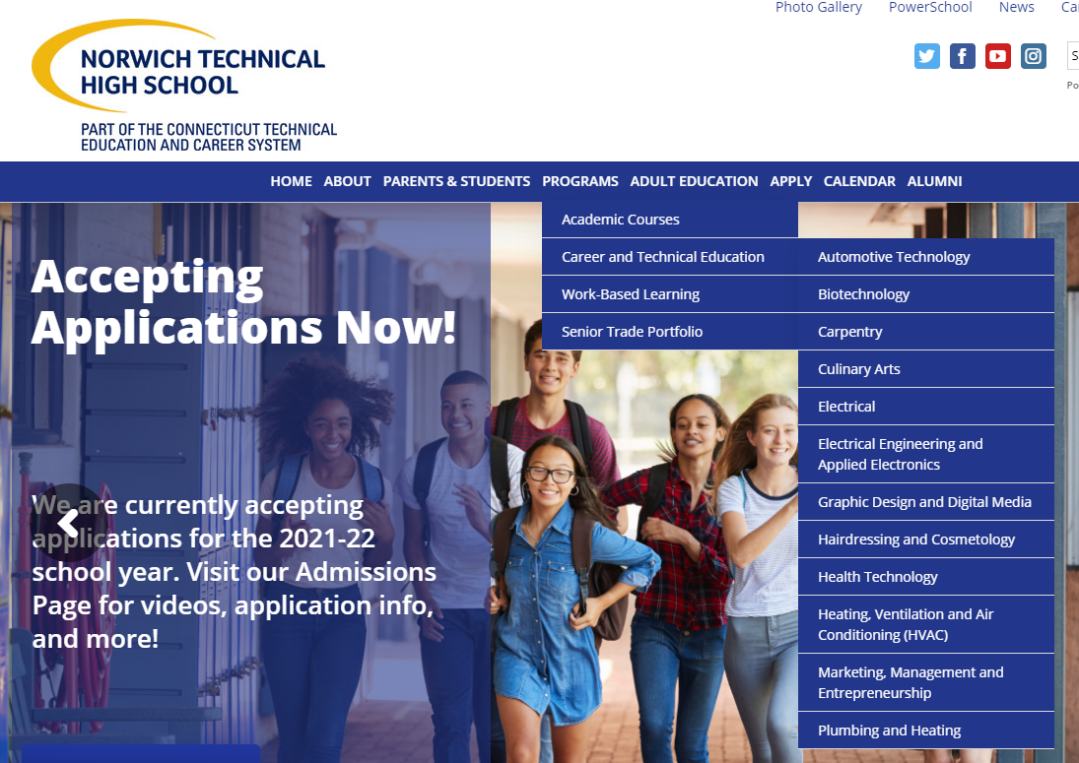
Carpentry Tool List
Located on the school website:
Google “Norwich Tech”
THEN :PROGRAMS”
Then: career and technical
THEN: CARPENTRY

Slide 4
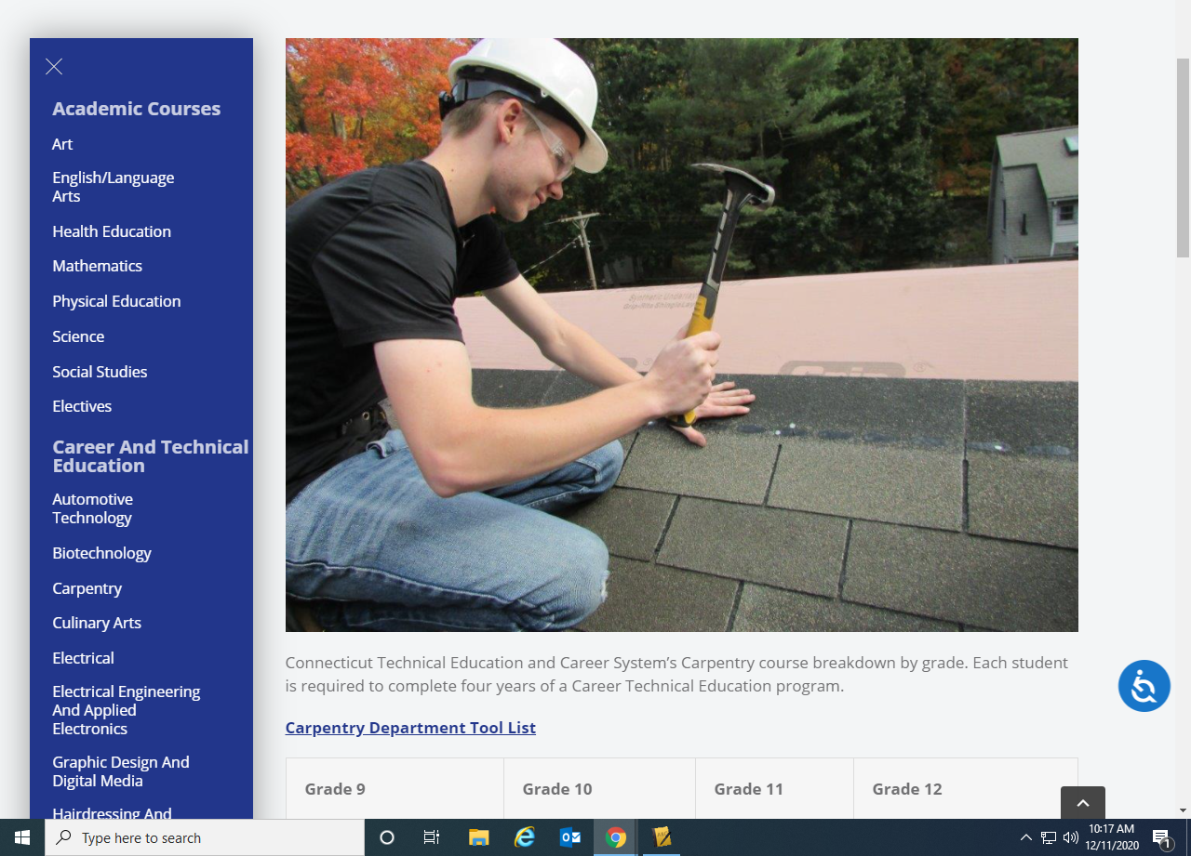
The Carpentry
Screen looks like this:
The tool list is located
here:

Slide 5
Tool List- descriptions and photos below
Tool Belt with Hammer Holder Twist Drill Set Electrician’s Pliers 8”
Speed Sqare Sliding T-Bevel Square *Optional Safety
Utility Knife (not folding) Compass Scribe/ Dividers Equipment:
Wood Chisels 1//4” to 1” Scratch Awl ear plugs or muffs
16’ or 25” tape measure Cat’s Paw/ Nail Puller Hard Hat needed
16 to 22 oz. claw hammer Small “wonder bar”/ trim bar for 11th grade
2 paint brushes Flat Bar pry bar 12” to 16”
Nail sets 1/32, 2/32, 3/32 Chalk Line with Blue Chalk
Pull Saw 6” slip-joint plier
Drill Driver Set 5-in-one screwdriver

Slide 6
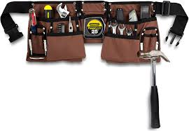
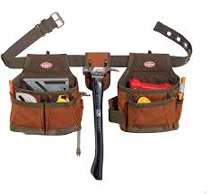
Tool Belt with Hammer Holster
All Carpenters wear tool belts. You will wear a tool belt every day While on
production in 11th and 12 grade
We recommend you DO NOT purchase
a tool belt with this type of belt
This type of belt is easier to make larger when
Wearing a jacket working in colder weather
Hammer holster

Slide 7
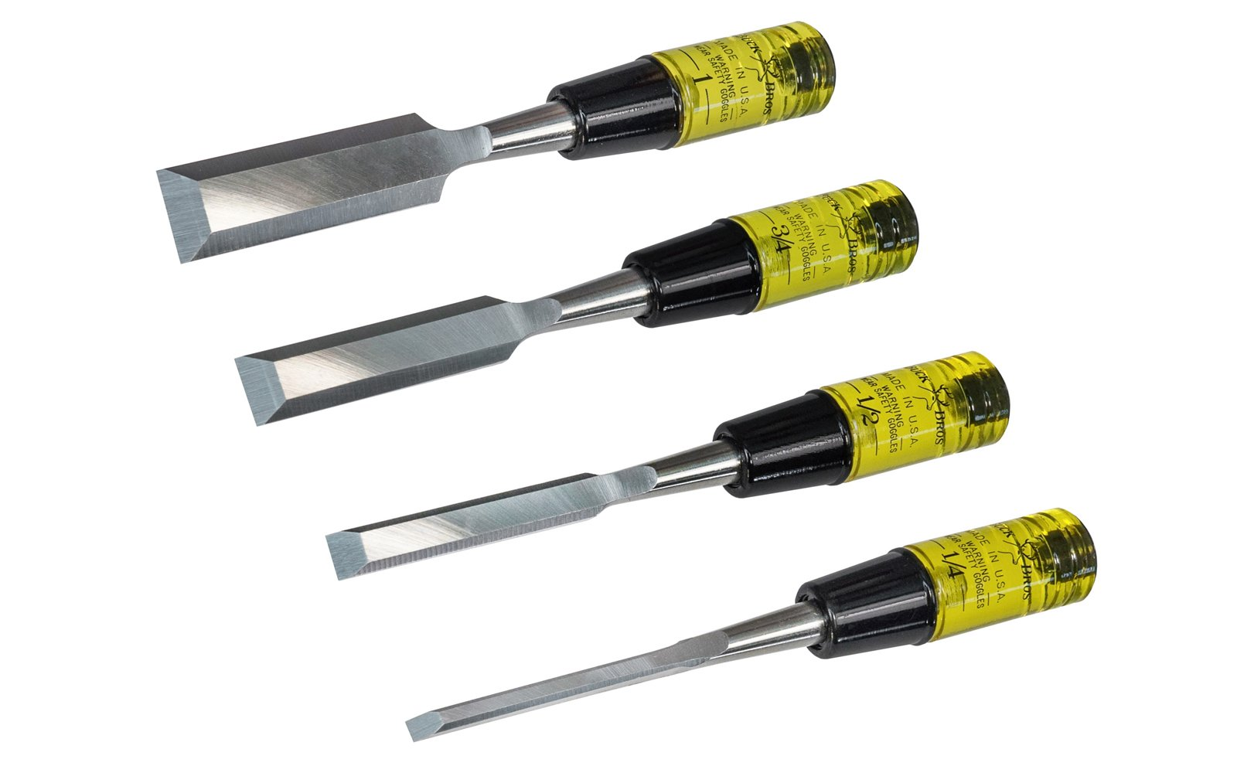
Wood Chisel Set
Wood chisel set ¼” to ½”

Slide 8
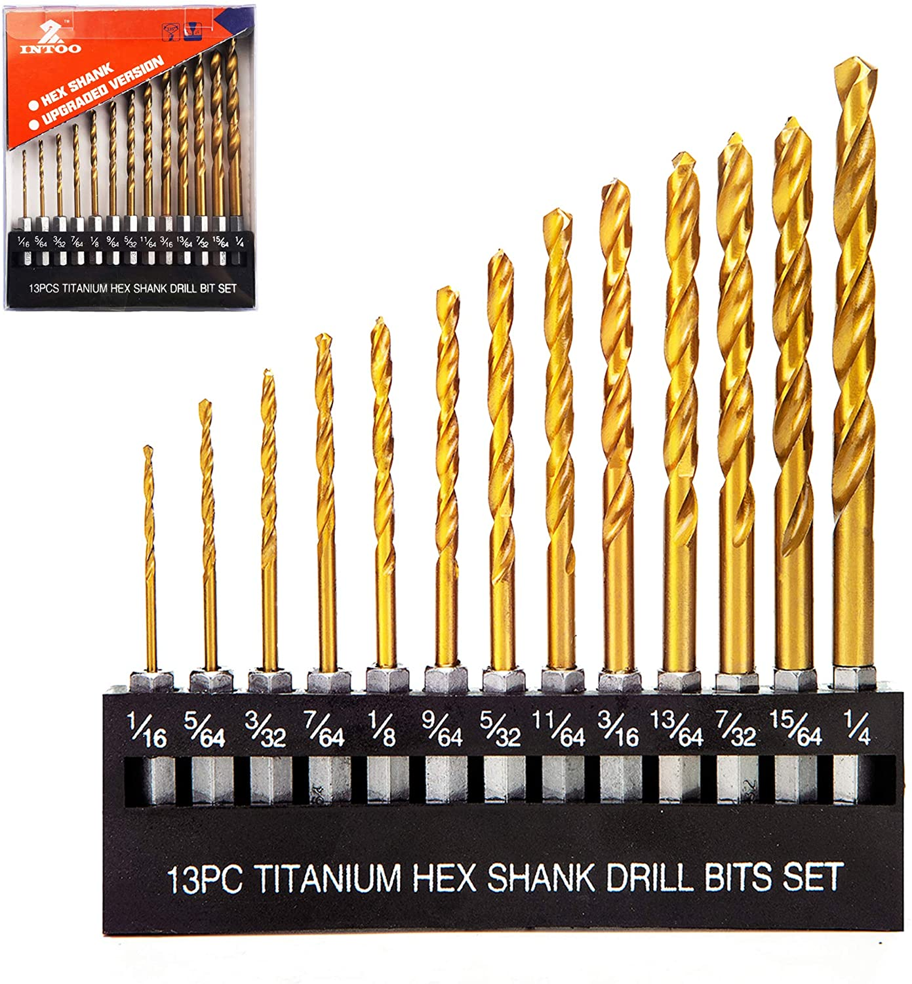
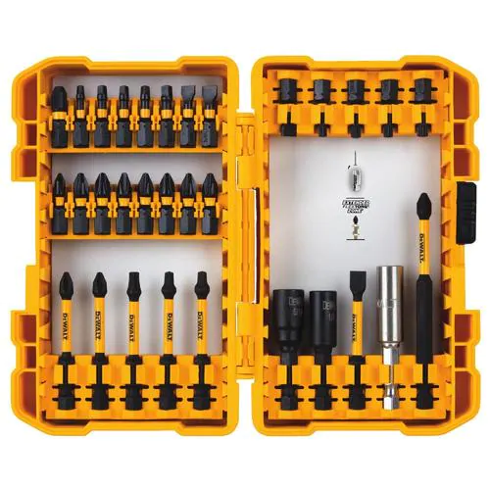
Twist Drill Set 1/16” to ½”
Drill Driver Set

Slide 9
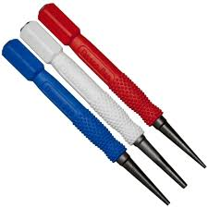
Nail set 1/32,2/32, & 3/32

Slide 10
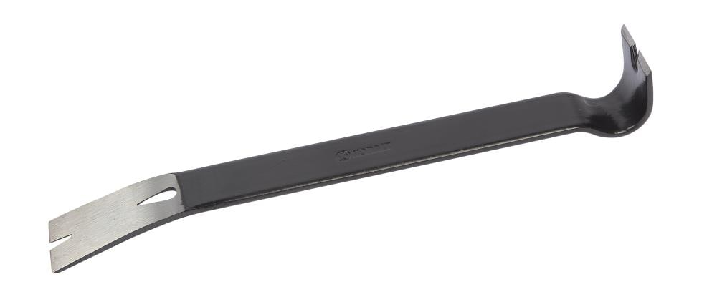
Flat pry bar
Must have 12” to 16”

Slide 11
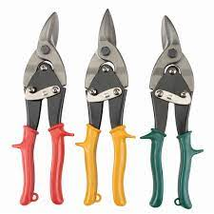
Aviation snips
Get a set of red, yellow, and green

Slide 12
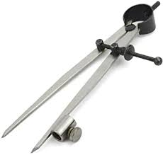
Compass Scribe/Dividers
In construction you would use a divider for making marks at certain measurements
Or drawing perfect circles
Purchase one that is about 6” long
DO NOT purchase one with a degree scale

Slide 13
Combination square
This is a combination square it has to be a 12 inch ruler.

Slide 14
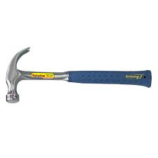
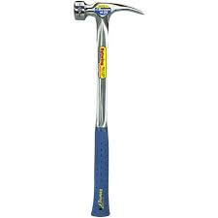
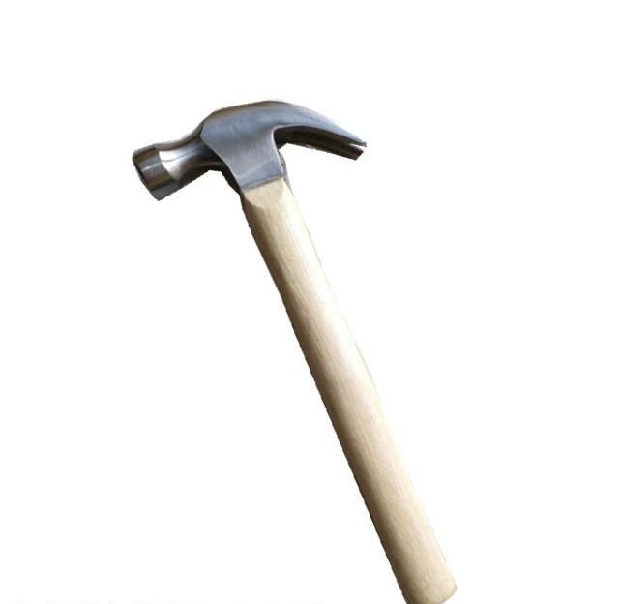
Hammer
16 to 22 oz claw hammer
Purchase either a curved claw
Or straight claw

Slide 15
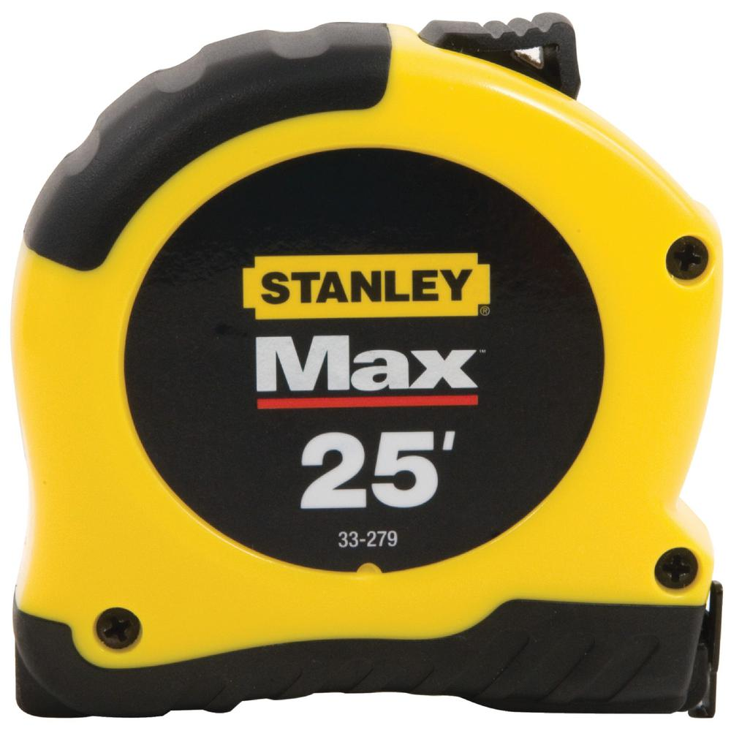
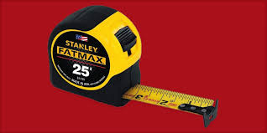
Tape measure- 16’ or 25’ tape measure

Slide 16
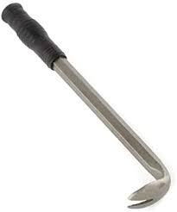
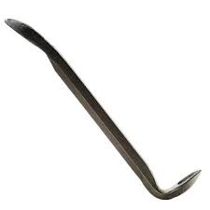
Cats Paw
Use to take out nails

Slide 17
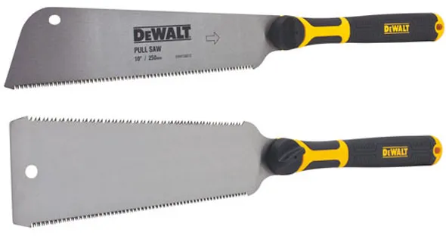
Pull Saw
cuts joining wood and kerfs when using plastic and laminate materials. With the handle placed in-line with the blade, a pull saw can form flush cuts and smooth incisions.

Slide 18
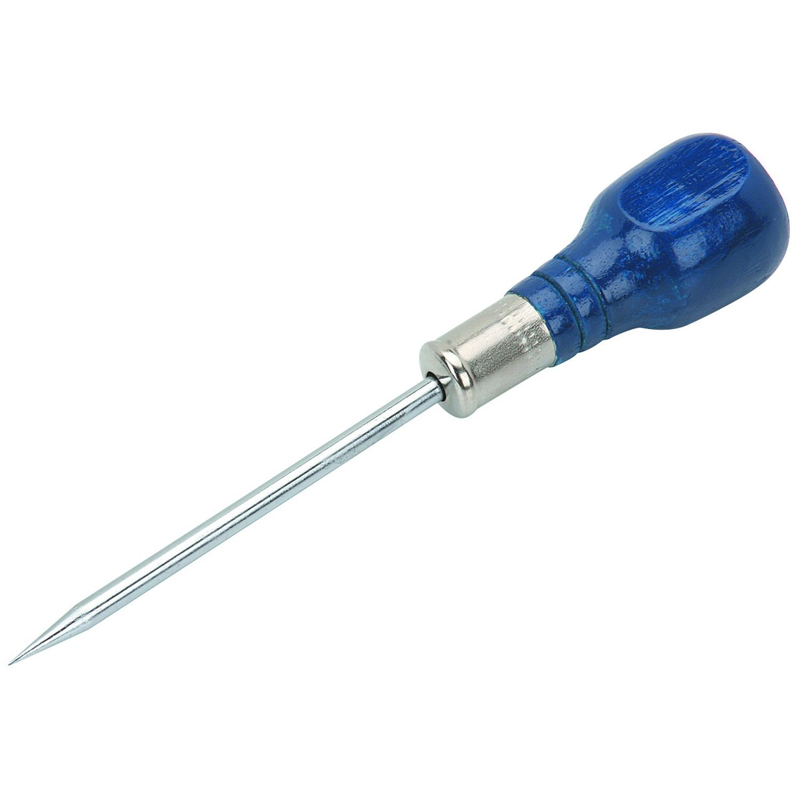
Scratch awl
A scratch awl is a woodworking layout tool amd point-making tool. It is used to scribe a line to be followed by a hand saw or chisel when making woodworking joints and other operations. The scratch awl is basically a steel spike with its tip sharpened to a fine point

Slide 19
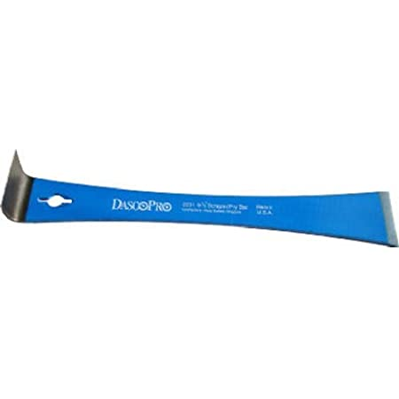
Small wonder bar or similar trim bar
Like most pry bars it's meant pulling nails, lifting and scraping. The difference lies in the material it is made out of being a more durable material being made out of high-carbon steel.

Slide 20
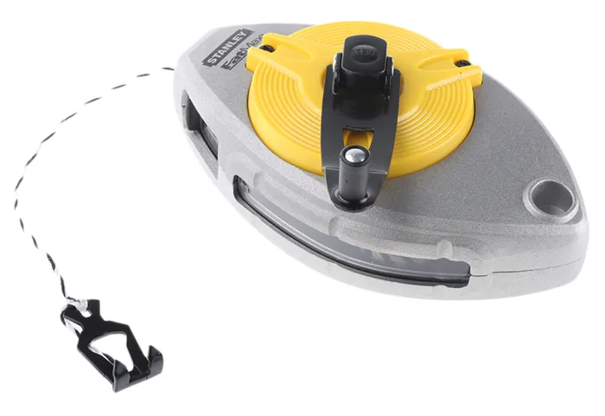
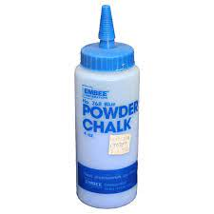
Chalk Line with Blue Chalk
Chalk line is used for roofing and framing. Red Chalk can stain clothing, etc.

Slide 21
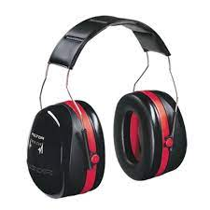
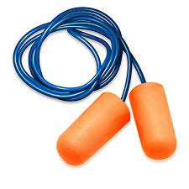
Earplugs or muffs

Slide 22
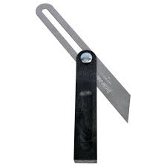
Sliding T-bevel

Slide 23
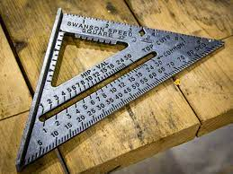
Speed Square
Purchase a 7”

Slide 24
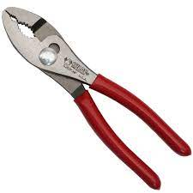
Slip joint pliers
6” or 8”

Slide 25
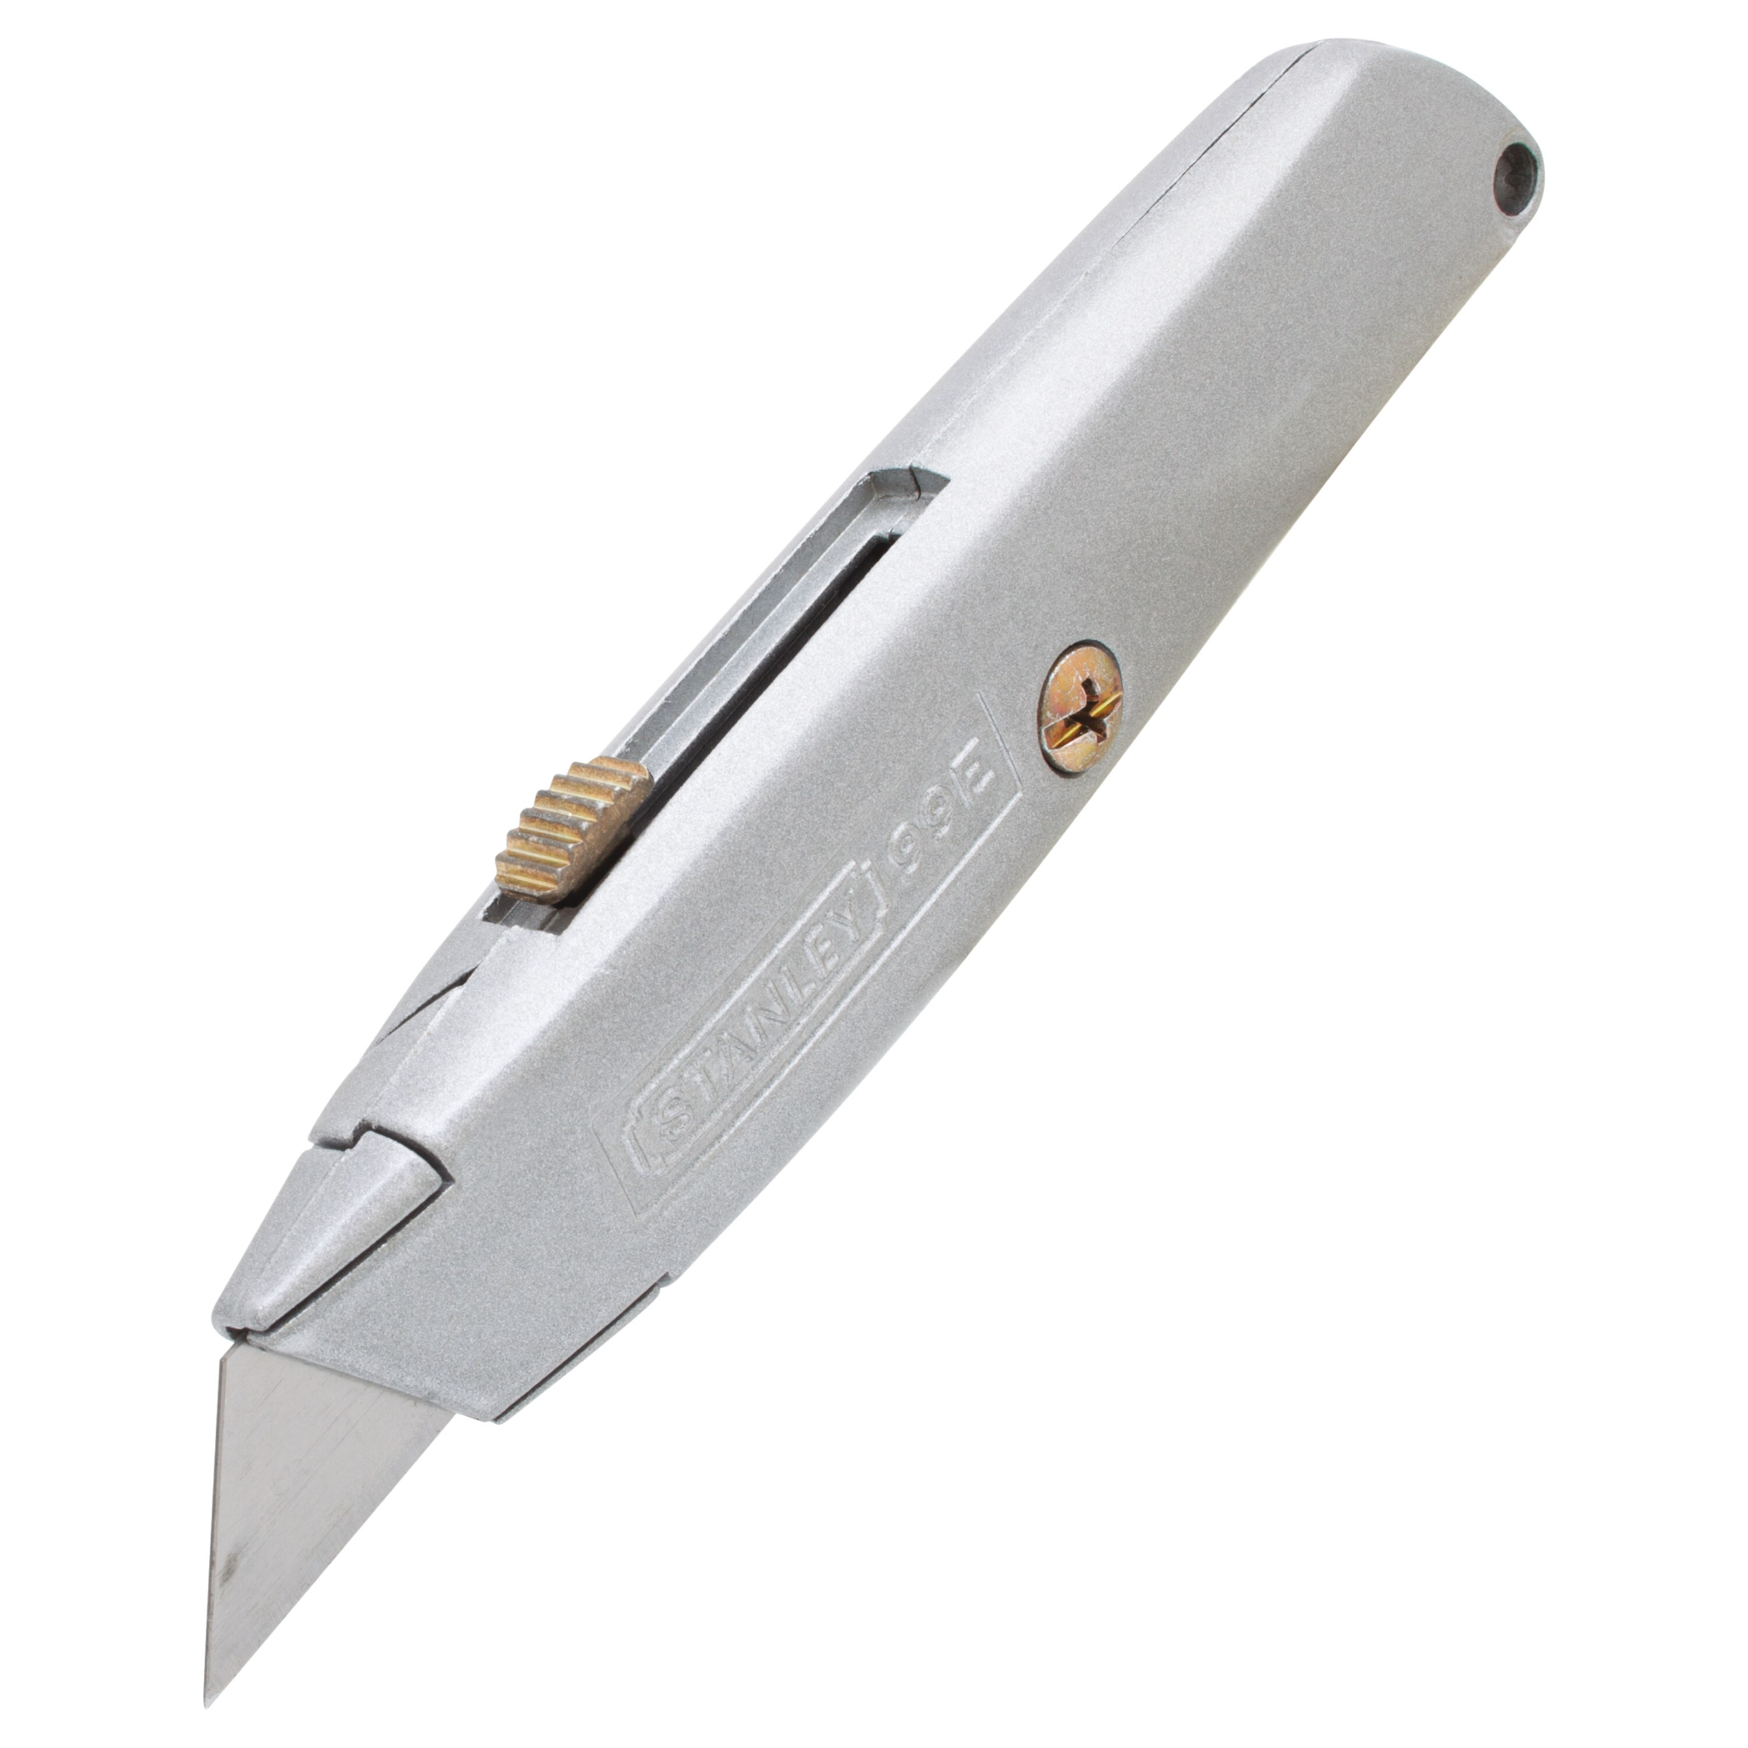
Utility Knife
Utility knives are used to cut and trim a variety of building materials including: drywall, felt paper, wallpaper, rope & twine, plastic sheet material, fiberglass insulation and more.
Folding type knives are NOT allowed
in school

Slide 26
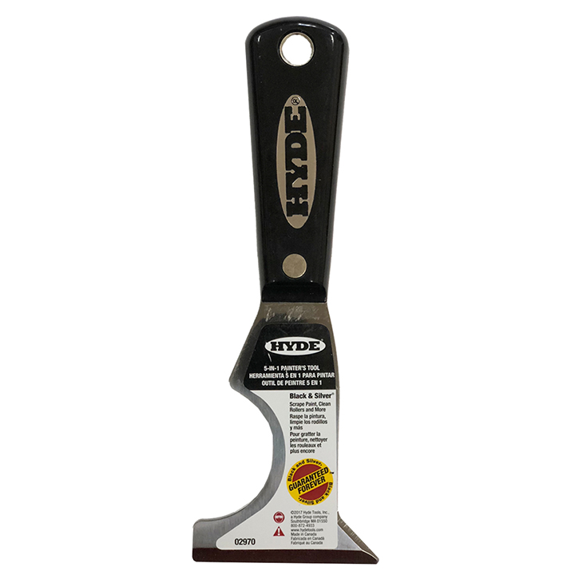
5 in 1 painter’s tool

Slide 27
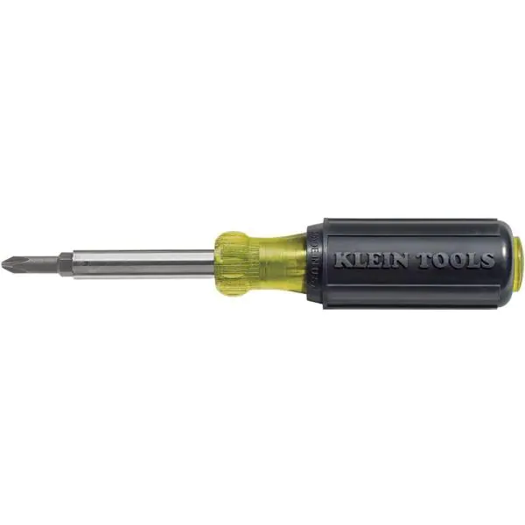
5 in 1 Screwdriver
It is a screwdriver that will reduce the number of individual nut drivers in your belt.

Slide 28
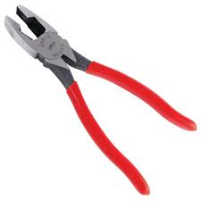
Electrician pliers
You must have 8 inch electrician pliers

